Slide 1
Emerging Technology: iPads in School
Jennifer D. Burke
ITEC 7445 – Summer 2013

Slide 2
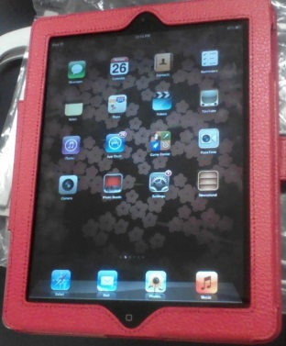
Background
Rawls, Danielle. ipad.jpg. 3/26/2012. Pics4Learning. 17 Jul 2013 <http://pics.tech4learning.com>
Across the United States and around the world, schools are embracing the use of iPads as an affordable, practical way to reach 1:1 student technology access while providing engaging, challenging content instruction.
The NMC Horizon Report (2011) identified use of mobile devices as one of six emergent technologies that will transform K-12 education.
Mobile devices – including iPads – allow students and teachers to take their technology with them, unconstrained by bulky boxes and wires.

Slide 3
Proposal
As Centennial Place Elementary School transitions from a K-5 traditional school model to a K-8 charter school, class sets of iPads should be purchased for each classroom, supporting our mission as an innovative, “break-the-mold” public STEAM school, and making the ideal of 1:1 computing a reality for our students.

Slide 4
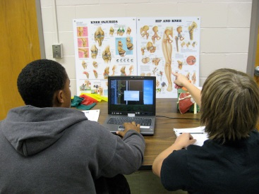
Learners Affected
Curry, Scott. img_00831.jpg. August 16th 2007. Pics4Learning. 17 Jul 2013 <http://pics.tech4learning.com>
Children from age 7 up (second grade) can use iPads comfortably because of their size, touch-screen interface and appealing multimedia learning materials.
Students younger than 7 will need more support and supervision.
Students with disabilities and English language learners will benefit from using the devices’ interactive multimedia materials.

Slide 5
Visionary Leadership
Atlanta Public Schools Technology Vision is expressed in the annual Local Education Authority (LEA) reauthorization documents provided to the U.S. Department of Education for school year 2012-13.
Innovative school level use of technology can transform education and significantly reduce current inequities in resource allocation.

Slide 6
Visionary Leadership
Specifically, APS believes technology will:
provide tools and resources to help educators improve instructional practices,
connect educators to learning, data, content, and systems,
implement relevant, rigorous, and engaging learning experiences that promote student creativity and learning,
measure and drive student learning,
create a comprehensive, device-neutral learning infrastructure,
Use best practices in technology to design and implement learning and organizational structural changes.

Slide 7
Strategic Planning
APS recently implemented 2012-2015 technology plan will establish an instructional model enabled by technology in support of the National Education Technology Plan of 2010, Transforming American Education: Learning Powered by Technology.

Slide 8
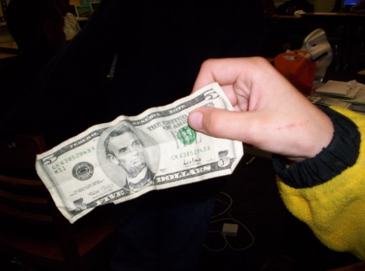
Funding
Bourgeois, Michelle. fivebill.jpg. March 2006. Pics4Learning. 16 Jul 2013 <http://pics.tech4learning.com>
Include mobile computing devices in standard district budget.
Seek outside funds or partnerships that support innovative technology-facilitated instruction.
Ask parents to pay a nominal annual technology fee
Reduce expenses by using free web-based software and apps

Slide 9
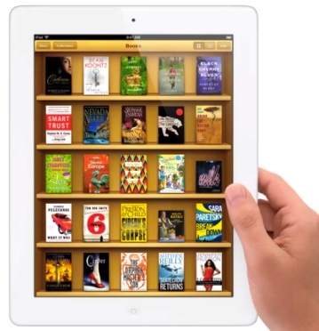
Content & Technology Standards
http://www.geekwire.com/wp-content/uploads/2012/03/ipad-books.jpg
iPads allow students to access learning content at any time and in any place.
iPads allow students to e-Books, cost effective and technology-based opportunities that fully engage students in interactive learning experiences.
Standards-based materials are constantly being developed and released for wide use.

Slide 10
Research-Based, Learner Centered
McGraw-Hill CINCH Science program is available to students through iPad, and has the potential to instruction for each student (Cohen, 2012).
iPads allow students to e-Books, cost effective and technology-based opportunities that fully engage students in interactive learning experiences.

Slide 11
Authentic Learning
Cable Poly U <http://cable.poly.edu/sites/default/files/imagecache/story_img/story_img/_MG_1759.jpg>
Students can use the iPad to explore topics more fully
One assessment found growth in two areas : search strategies and evaluating web sources, both 21st century skills used every day in our digital world (Cohen, 2012).

Slide 12
Higher Order Thinking
Students create rich and varied work by combining applications and content.
Collaborative activities and communication foster analysis and critical thinking

Slide 13
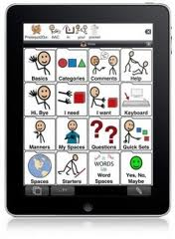
Differentiation
http://www.friendshipcircle.org/blog/wp-content/uploads/2011/02/ipad-apps-e1297022632574-220x300.jpg
iPads give teachers and staff new options to accommodate different learning abilities.
iPads provide access to multimedia and read-aloud technology which support students with disabilities and English language learners.

Slide 14
Differentiation
“What seems to make the implementation of the iPad into the classroom successful in terms of the instructor is the personalization of the devices to very specific instructional needs. The iPad is useable, portable, and quick to move from application to application.“ (Mahaley, 2013)

Slide 15
Instructional Design
Learning has an anytime-anyplace access approach.
Learning can take place in any environment.
Lessons are flipped – students become their own teachers; teachers are facilitators.
Documents become active tools.
Teachers have to evaluate resources and provide richer content that includes multimedia.

Slide 16
Collaborative Learning
iPads support “cloud” interfaces for group collaboration; e.g. student-created wikis define how collaborative spaces are now used in education.
Mindmeister is an example of a collaborative mind-mapping tool available for iPad.

Slide 17
Equipment & Software
Although iPads function on their own, special heavy-duty cases will protect the devices from accidental damage during classroom use.
iPads can only print documents via specially-enabled “AirPrint” printers but these are becoming more readily available.

Slide 18
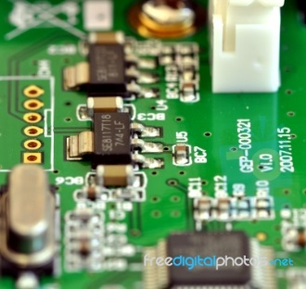
Technical Support
Circuit Board Stock Photo
By Michelle Meiklejohn, published on 29 October 2009 Stock Photo - image ID: 1009177
As Apple products, AppleCare support can be purchased for the devices
Apple products are less susceptible to viruses and malicious software

Slide 19
Limitations
Access to a robust wireless network is critical to allow for multiple simultaneous users.
Even with specialized apps, occasionally materials will not display correctly or as expected, for example html-enabled e-mail and some websites.
They are easily dropped and screens will break, hence the need for special cases, AppleCare support, and insurance.

Slide 20
Cost
Free, high quality educational applications are widely available for use on iPads, which is especially helpful given the budget constraints of most schools (Wilson, 2013).
iPad cost has been steadily declining as each new iteration is introduced to the consumer market.
A refurbished iPad 3 can cost $349; the iPad 2 retails for $399. Processing speed and display affect pricing.
Schools can negotiate contract pricing for volume purchases.

Slide 21
Research on Use
iPads have been found to change student performance.
Students tend to submit assignments on deadline, deliver higher quality work (Mahaley, 2013), and are more engaged in class.
Standardized test results are only beginning to reflect steady growth documenting the success of the project.
Dr. Donald Leu at University of Connecticut is currently conducting research on high school students’ ability to locate resources, evaluate resources, synthesize information, and communicate through blogs or wikis (Cohen, 2012)

Slide 22
Communication
Girl Chatting On Internet Stock Photo
By Stuart Miles, published on 26 August 2011 Stock Photo - image ID: 10055380
Web-based technology such as that accessed through iPads makes education a “participatory medium in which educators, parents, students, and community members are both producers and consumers of information” (Page, 2008)

Slide 23
Safe, Healthy, Legal & Ethical Issues
Students should participate in developing policies and procedures for iPad use in school, including consequences for inappropriate use.
Students will benefit from having ethical practices incorporated throughout instruction.
Technology use by very young children is developmentally appropriate when use is limited to specific instructional activities.
As with any technology use, students should be supervised by an adult.

Slide 24
Diversity
iPads allow individualized instruction in ways never before seen in schools.
Each student will interact with the iPad in his own way, and use it to control his own learning
Early Learning Coalition of Hillsborough County - Tampa, Floridawww.elchc.org

Slide 25
Professional Learning
Courses, workshops, and seminars can be offered as online, asynchronous learning using iPads.
Training is made more accessible while easing scheduling conflicts.
It is important to train in small doses.
Training must be relevant and sustained, and teachers need to practice new skills immediately.

Slide 26
Implementation
Funding considerations and concerns about intermittent wi-fi connectivity support proposing a gradual iPad implementation plan.
Include iPad use procedures in Acceptable Use Policy signed by parents each year. iPads would remain in the school building for use during the school day.
Year 1 – purchase class sets for grades 3-5
Year 2 - purchase class sets for incoming 6th graders
Year 3 - purchase class sets for first and second grades and rising 7th graders
Year 4 – Purchase class sets rising 8th graders and begin replacement plan for original purchases
Provide ongoing funding to replace iPads lost to damage.

Slide 27
Reflection
This presentation represents a 180-degree shift in my own thinking. Six months ago I eschewed all use of any Apple product. However, after being gifted with one three months ago, I have become a disciple of apps and see myriad opportunities to engage students through using iPads.
I have seen first-hand how engaged with learning students are when using iPads, and I have gotten a glimpse of the possibilities offered to disengaged students, English Language Learners and student with disabilities.

Slide 28
References
Cohen, S. (2012). A 1:1 iPad initiative: vision to reality. Library Media Connection, 30(6), 14-16.
LEA Consolidated Application. (2012). Atlanta: Atlanta Public Schools.
Mahaley, D. (2013, July 16). Teaching and Learning with the iPad – a 3 Year Review (Parts 1 and 2). EmergingEdTech. Education Technology. Internet and instructional technologies for teachers & other educators. Retrieved July 16, 2013, from http://www.emergingedtech.com/2013/07/teaching-and-learning-with-the-ipad-a-3-year-review-part-2/
NMC Horizon Project. The New Media Consortium. (n.d.). The New Media Consortium. Sparking innovation, learning and creativity. Retrieved July 16, 2013, from http://www.nmc.org/horizon-project
Page, G. A. (Director) (2008, October 16). Top 10 Web-based educational technologies. College of Education. Lecture conducted from University of Alaska, Anchorage.
Wilson, I. (n.d.). iPads in Education. iPads in Education. Retrieved July 16, 2013, from http://www.ipadineducation.co.uk/
Zappa, M. (n.d.). The future of education technology | Envisioning Technology. Envisioning emerging technology for 2012 and beyond (by Michell Zappa). Retrieved July 16, 2013, from http://envisioningtech.com/education/

